Slide 1
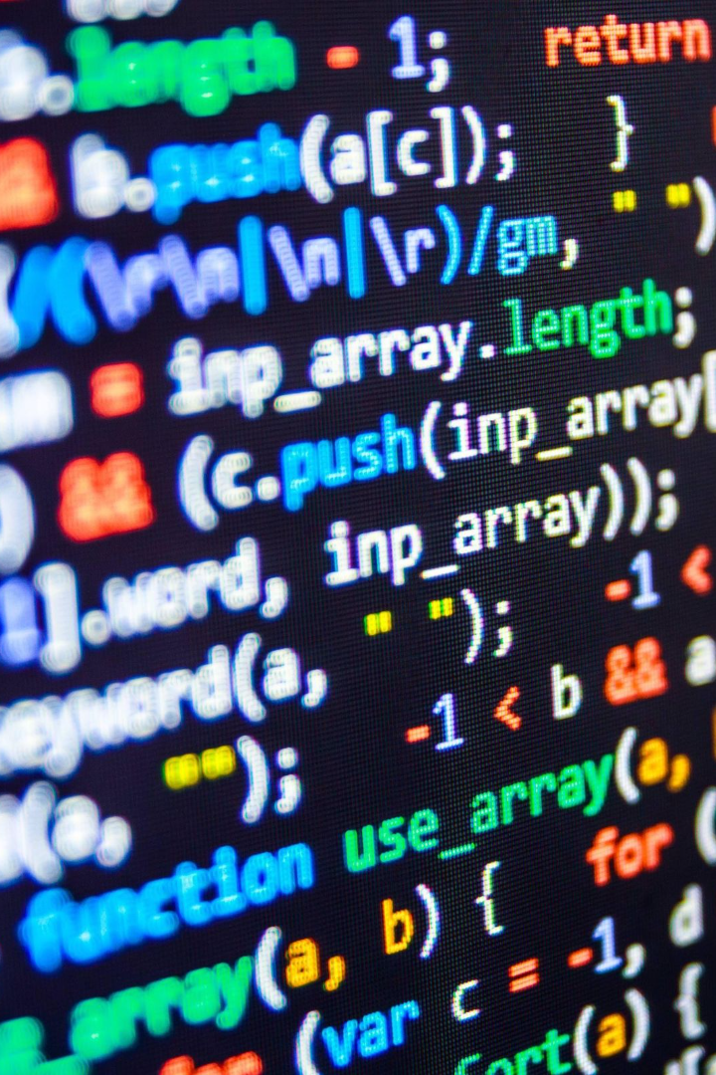
Building an Amazing Chatbot
Learn how to build a powerful and intelligent chatbot by preparing the environment and implementing basic user interactions.
By shakthisanthosh k
D

Slide 2
Preparing the Environment
1
Installing Required Libraries
Utilize transformers for seamless integration of GPT-3, a cutting-edge language model, and flask for web app development.

Slide 3
Implementing Basic User Interactions
Building the Chatbot
Testing and Refining the Chatbot
Set up the foundation of your chatbot by defining user prompts and crafting intelligent responses.
Iterate and fine-tune your chatbot through continuous testing and feedback, ensuring optimal performance and user satisfaction.

Slide 4
The Power of GPT-3 Integration
1
Improved Natural Language Processing
GPT-3 allows your chatbot to comprehend and respond to user queries with exceptional accuracy and fluency.
Enhanced Language Generation
2
Exploit GPT-3's advanced language generation capabilities to produce human-like and contextually relevant chatbot responses.
3
Seamless Integration
Streamline the implementation process by leveraging the user-friendly transformers library for effortless GPT-3 integration.

Slide 5
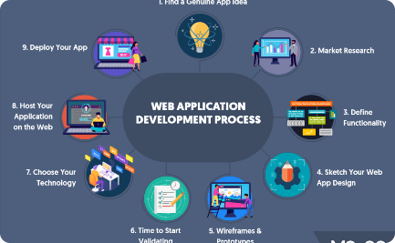

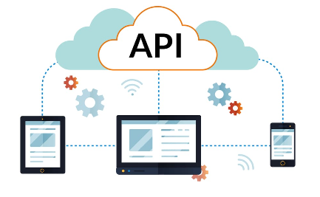
Web App Development with Flask
Create Dynamic Chatbot UI
Efficient Backend Development
Seamless API Integration
Leverage Flask's robust API integration features to seamlessly connect your chatbot to external services and databases.
Explore the versatility of Flask to build an interactive and visually appealing user interface for your chatbot.
Harness Flask's powerful capabilities to develop the backend functionality of your chatbot with maximum efficiency.

Slide 6

Building a User-Centric Experience
1
Understanding User Intent
2
Embracing Natural Language Understanding
3
Designing a Conversational Interface
Use techniques such as user profiling and intent analysis to ensure your chatbot provides personalized and relevant responses.
Implement natural language understanding algorithms to enhance your chatbot's ability to comprehend and respond accurately.
Create a seamless and intuitive user experience by designing a conversational interface that feels natural and engaging.

Slide 7
Taking Chatbots to the Next Level
Expanding Functionality with APIs
Intelligent Error Handling
Incorporating Machine Learning
Implement error handling mechanisms to improve user experience and guide users towards finding the information they need.
Apply machine learning techniques to train your chatbot and optimize its performance, accuracy, and ability to learn from user interactions.
Integrate powerful APIs into your chatbot to offer additional features such as weather updates, news headlines, or even e-commerce capabilities.

Slide 8

Deploying Your Chatbot
1
Cloud Platform Integration
Deploy your chatbot on popular cloud platforms like AWS, Google Cloud, or Azure to ensure scalability, reliability, and global accessibility.
2
Monitoring and Analytics
Track user interactions, measure performance metrics, and gain insights using analytics tools to continuously improve your chatbot.
3
User Feedback and Iteration
Encourage user feedback and iterate based on real-world usage data to enhance your chatbot's effectiveness and user satisfaction.

